Slide 1
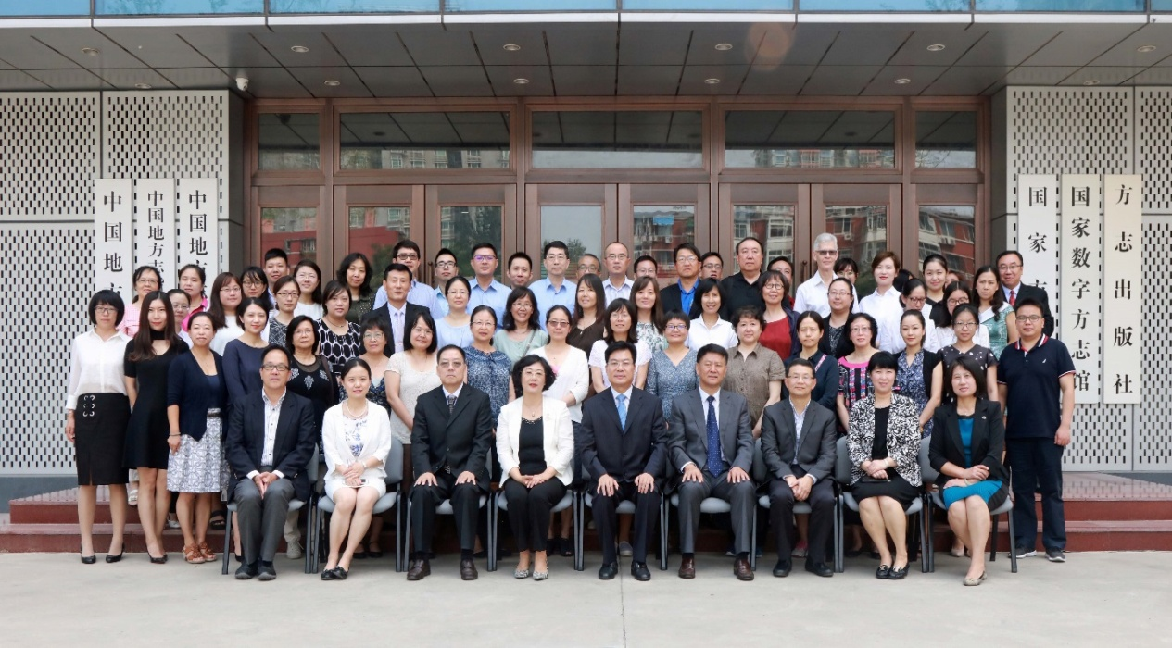
What Do We Need Now? : Highlights of CCM's 2017 Summer Workshops in Beijing
Jianye He (CCM member)
Librarian for Chinese Collections
University of California, Berkeley
March 21, 2018

Slide 2
Outlines
Resources for core collections: local gazetteers
Less known resources: ethnic minorities
studies materials
Evolving resources: materials on arts & archaeology
What else do we need?

Slide 3
Resources for core collections: local gazetteers
Facts we learned: 469 Local Records Libraries 方志馆 (1 national, 17 provincial, 101 municipal, 350 county level); The National Local Records Library has the largest collection : ca.10,000 titles,300,000 vls. of gazetteers (including surveys of over 20 provinces/cities and 530 counties in 1950s-1960s; manuscript gazetteers compiled in 1970s-1980s; 8,500 yearbooks)
One national project: China Local Records Nets （中国方志网, the national resource management system for integrating local gazetteers, annals, yearbooks, periodicals, audio-video materails, etc.）http://www.difangzhi.cn/zgdfz/index.shtml

Slide 4
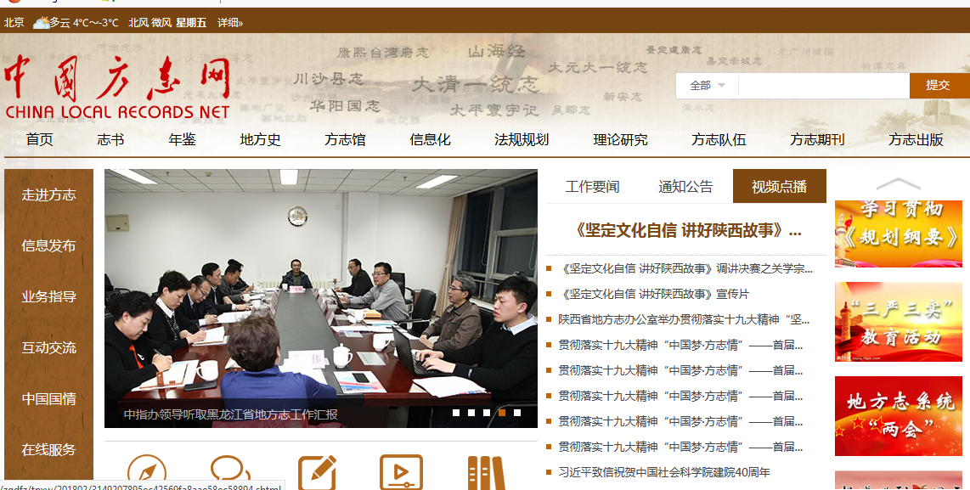
Resources for core collections: local gazetteers

Slide 5
Resources for core collections: local gazetteers
Publishing projests of the Chinese Local Records Publishing House:
⃰ Over 8,000 titles (100,000 vls.) gazetteers are published
⃰ Eight brand series （八大名牌系列）are established:
High-quality yearbooks 名鉴
Gazetteers of famous towns and villages名镇名村志
Poverty reduction program reports扶贫志
Seleted gazetteers on social science subjects 社科精品志
Theoretical studies on local gazetteers方志理论研究著作
Publications of renowned historical gazetteers历代名志整理出版系列
gazetteers as products of “Chinese culture going global” strategy “方志文化走出去”系列
China local records publishing website中国方志出版网

Slide 6
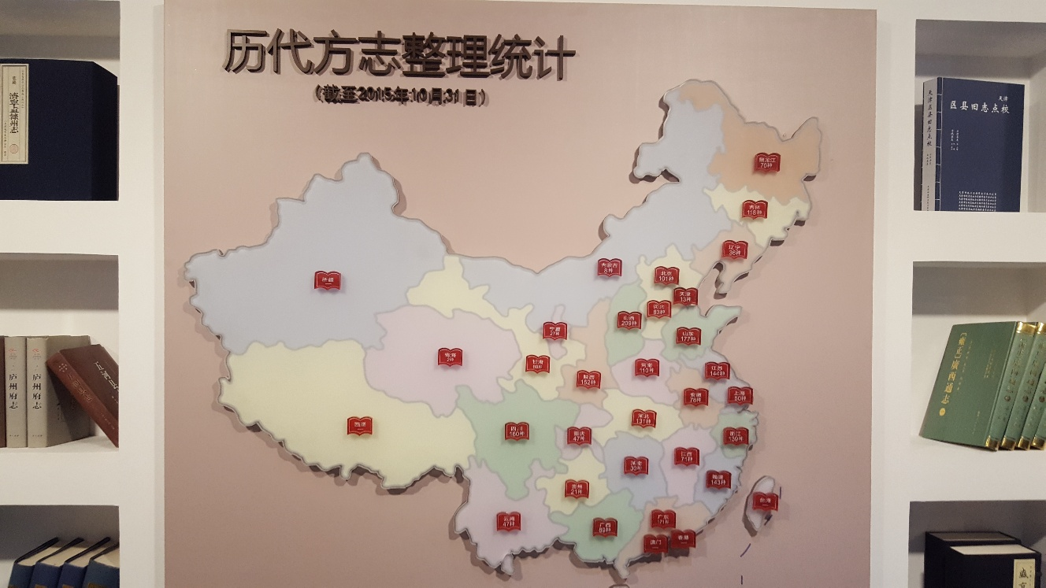

Slide 7
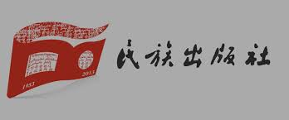
Less known resources: ethnic minorities studies materials
Less known resources: ethnic minorities studies materials
The Minzu Publishing House 民族出版社:
Publishes over 1,000 titles/year in eight languages (including Mongolian, Tibetan, Korean, Uyghur, etc.)
Strength of the publication: policy toward ethnic minorities affairs, ethnic minorities works and knowledge, religions of ethnic minories, translated literary works in ethnic minorities languages, editing and publishing of classic ethnic works, etc.
Qinghai Minzu Publishing House 青海民族出版社:
Major publisher for Tibetan

Slide 8
Less known resources: ethnic minorities studies materials
Strength of publications: Classics of Tibetan traditional culture （藏族传统文化典籍）, Tibetan literature （藏族文学）, collection of historical and cultural celebrities of Qinghai （青海历史文化名人文库）, gazetteers and local history resources （志书与地方文献）, 21 century Tibetan writers series （二十一世纪藏族作家书系）, etc.
Minzu University of China Press 中央民族大学出版社:
Publishing in eight ethnic minorities languages: uyghur, Mongolian, Manchu, Tibetan, Hmong, Korean, Tujia, Oroqen;
Recommendations of publications: 中国民族研究文库, 藏文典籍, “一带一路”与中亚文化，百年民族学, etc.
Bilingual textbooks

Slide 9
Less known resources: ethnic minorities studies materials
Xinjiang Culture Publishing House 新疆文化出版社:
Publishing in these ethnic minorities languages: uyghur, Kazakh, Mongolian, Manchu, Arabian, Russian, Turkish, Slavic, Kyrgyz, etc;
Strength of publications: history of Xinjiang, sources on silk road, Xinjiang folk literature and arts, cultural relics and archaeology, etc., such as《西域壁画全集》、《西域考古图谱》、《新疆工艺美术丛书》、《历代碑刻文字拓本》、《西域文物考古全集》、《中国古代书画文献辑录》、《新疆世界文化遗产》、《西域民族文化图典》等。

Slide 10
Evolving resources: materials on fine arts & archaeology
Evolving resources: materials on fine arts & archaeology
The Forbidden City Press is a leading publisher for books on fine arts & archaeology. The source of their publication is from these special collections:
The Palace Museum’s treasure contains 25 class, 59 catagories. Over 83% are Ming Qing collections.
The Palace Archive has more than 10 million pieces of archives
The Palace Library has more than 2.8 million volumes of books.

Slide 11
Evolving resources: materials on fine arts & archaeology
The Forbidden City Press’s five editorial offices and publications:
Calligtaphy and Paintings 书画部: 《石渠宝笈》、《故宫藏四僧书画全集》、《徐渭书画全集》、《故宫藏四僧书画全集》等；
Artifacts 器物部: 《大英博物馆中国民间陶瓷》等；
Palace History 宫廷历史部: 《明代宫廷建筑史》、 《宫廷史学术研讨会论文集》等；
Culture & Tours 文化旅游部: 《清宫南府升平署戏本》、《清宫陈设档案》、《故宫藏稀见方志丛刊》等；
Archaeology 考古部：《故宫博物院院刊》、《汉代画像石通论》等；

Slide 12
What else do we need?
More open access resources (such as corpus text)
Bi-lingual/multi-lingual and multi format resources (including maps, images, datasets, reference tools)
Interdisciplinary/multi-disciplinary resources
Specialized database (such as archaeology/cultural relics database)
More customized and creative vendor service
Emerging new service: such as acquiring image usage permission from publishers for scholarly publication

Slide 13
“It was the best of times, it was the worst of times...It was the spring of hope, it was the winter of despair, we had everything before us, we had nothing before us...”
---A Tale of Two Cities
Our dialogue and exploration will continue...

